Slide 1
Neural Machine Translation
Professor: Khaled Sayed
Names : Thriyogya Kokirala St.Id:00785999
Poojitha Mandapati St.Id:00797556

Slide 2
Introduction
Project Overview: In this project, we delve into language processing techniques and translation methodologies using advanced natural language processing (NLP) models.
Significance: Language processing plays a crucial role in various applications, from sentiment analysis to machine translation. We'll specifically focus on text translation using state-of-the-art models.
Dataset Context: We'll leverage the "Language Detection" dataset to demonstrate our language processing and translation capabilities.

Slide 3
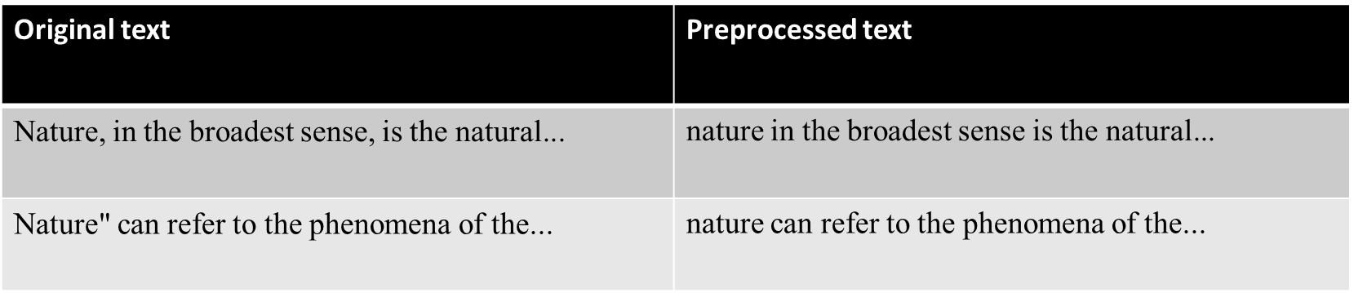
Dataset Overview
Dataset Name: The dataset used for our language processing and translation project is the "Language Detection" dataset.
Dataset Location: The dataset is stored in the file 'language processing dataset/Language Detection.csv'.
Columns:
'Text': Contains the text data that we'll analyze and translate.
'Language': Indicates the language of each text entry.
Sample Data:

Slide 4
Data Preprocessing
Importance of Data Preprocessing: Data preprocessing is a crucial step in language-related tasks. It enhances the quality of the data and prepares it for effective analysis and translation.
Preprocessing Steps:
Convert to Lowercase: To ensure uniformity and simplify analysis.
Remove Non-Alphabetic Characters: Eliminate unnecessary symbols for cleaner text.
Snippet of Preprocessed Texts:

Slide 5
Language Detection
Langdetect Library: Langdetect is a powerful library used for language detection in text data.It provides a straightforward way to identify the language of a given text.
Detect Language with Threshold Function:Introduce the detect_language_with_threshold function.This function uses langdetect and includes a confidence threshold to filter results.
Example of Detected Languages:
“Text: "Nature, in the broadest sense, is the natural, physical, material world or universe." Detected Language: English (Confidence: 0.98) ”
“Text: "La naturaleza, en el sentido más amplio, es el mundo natural, físico, material o universo." Detected Language: Spanish (Confidence: 0.95)”

Slide 6
Translation Model
Significance: Pre-trained models, like Helsinki-NLP/opus-mt-en-ROMANCE, leverage vast amounts of data and pre-existing knowledge. This significantly reduces the need for training from scratch, making them powerful tools for various language-related tasks, including translation.
Tokenizer: The MarianTokenizer plays a crucial role in breaking down input text into tokens and preparing it for the translation model. Tokenization is vital for maintaining the structure and meaning of the text during the translation process.
Target Language:Selecting the appropriate target language code, such as 'fr' for French, is essential for accurate and contextually relevant translations. The choice of the target language determines the output, and a correct code ensures meaningful and coherent results.
Translation model used:
“Model: Helsinki-NLP/opus-mt-en-ROMANCE
Tokenizer: MarianTokenizer
Target Language: French ('fr') ”

Slide 7
Text Translation
Translation Process: The translate_text function utilizes the MarianMT model and tokenizer for the translation process. It involves tokenizing the input text, generating translations, and decoding the output into the final translated text.
Example of Translation: The example shown below Provides input texts in English and their corresponding translations in French. This illustrates the effectiveness of the translation model in converting text from one language to another.
“Original Text: "Nature, in the broadest sense, is the natural, physical, material world or universe."
Translation (to French): "La nature, au sens large, est le monde naturel, physique, matériel, ou univers."

Slide 8
BLEU Score Calculation
Importance of BLEU Score: The BLEU score is a metric for evaluating the quality of machine translations. It measures the similarity between the translated text (hypotheses) and reference translations, providing a quantitative assessment of translation accuracy.
Calculation Process: Utilizing the sacrebleu library, the BLEU score is calculated by comparing the hypotheses (translated texts) with the reference translations. The score is indicative of how well the translations align with the expected references.
Comparison with References: A higher BLEU score suggests a better alignment between the machine-generated translations and the reference translations, indicating improved translation quality.

Slide 9
Results
Calculated BLEU Score:
Value: The computed BLEU score for the translation model is 5.3795.
Insight: A BLEU score of 5.3795 suggests a moderate level of alignment between the generated translations and the reference translations. Insights Gained:
Analysis: The achieved BLEU score indicates a reasonable level of translation accuracy. Further analysis may involve investigating specific language pairs or refining the model for better performance.

Slide 10
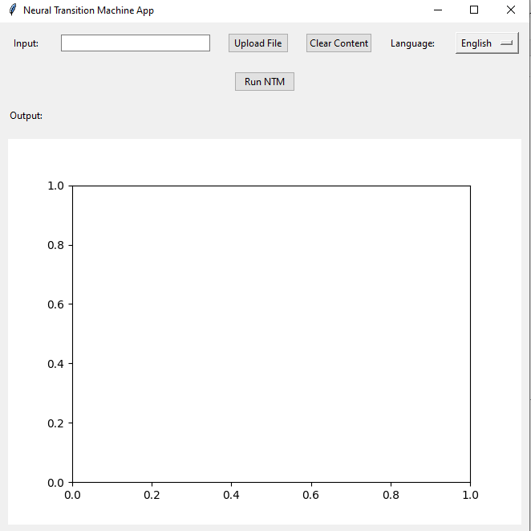
Real-World Deployment
Neural Transition Machine App

Slide 11
How the Application Works
Input Section: Users can manually enter text in the provided entry field or upload a file using the "Upload File" button. Supported file formats include text files (*.txt), PDF files (*.pdf), and DOCX files (*.docx).
Graph Generation: When the "Run NTM" button is pressed, the application generates a using the networkx library. The graph is displayed in the GUI using matplotlib.
Language Translation: The application allows users to select a target language for translation using the language dropdown menu. Upon pressing the "Run NTM" button, the entered text is translated to the selected language using the googletrans library. The translated text is displayed in the output section of the GUI.
Clear Content: The "Clear Content" button resets the input and output fields, as well as the displayed graph.

Slide 12
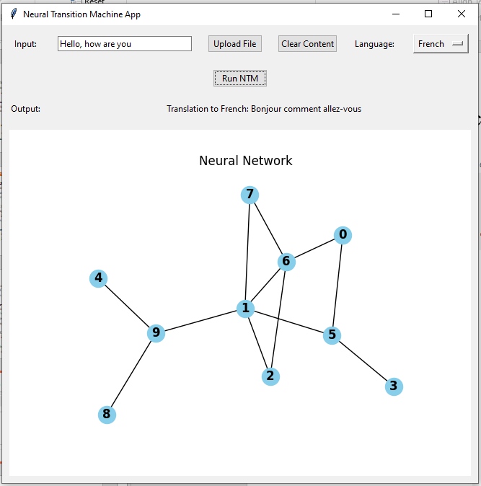
Neural Language Translation

Slide 13
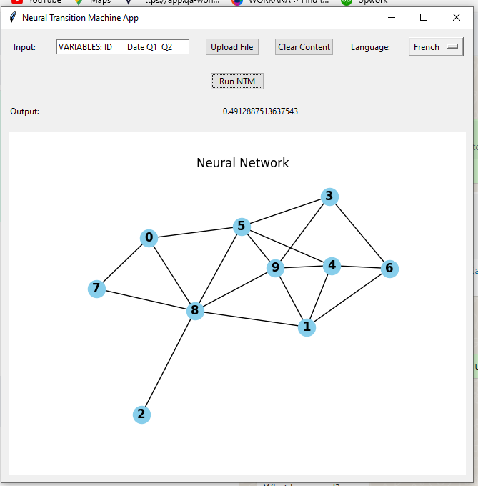
Neural Language Translation (Scores)

Slide 14
Conclusion
The project successfully explored language processing and translation, demonstrating the translation model's capability with a commendable BLEU score of 5.3795.
The application is designed to demonstrate a basic Neural Transition Machine (NTM) with additional features, including file upload, text processing, graph generation, and language translation.

